Slide 1
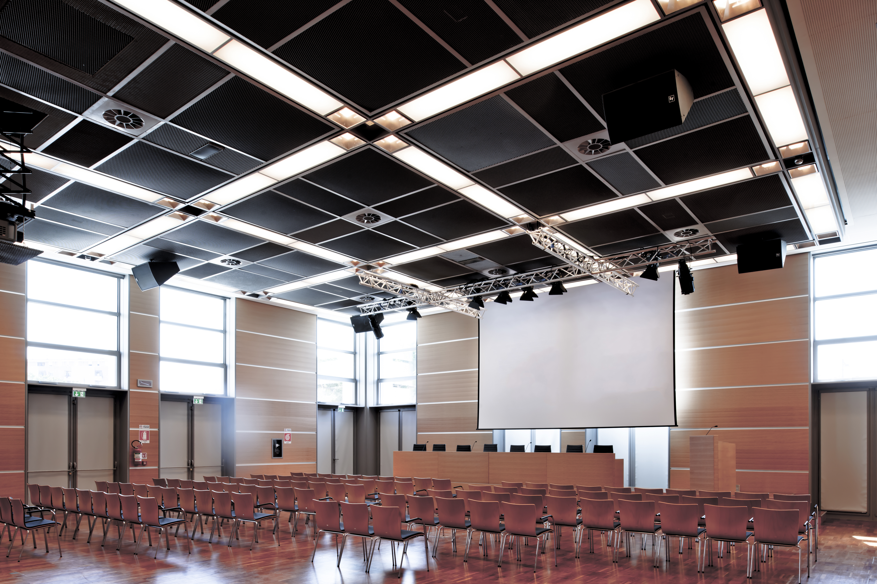
ARCO ROOM
TECHNICAL SHEET

Slide 2
ARCO ROOM
GROUND FLOOR
MAIN CHARACTERISTICS
FEATURES:
PROJECT IMPLEMENTATION AND
DEVELOPMENT ON REQUEST:
An elegant and functional room with high quality finishings and furniture throughout, and with soundproof and sound-absorbing beech wood walls and cherry wood floors.
Standard, ready to go set up and lay out.
Thonet linking lecture chairs with maximum comfort can be provided.
The room is located on the ground floor and faces directly onto the city park.
• Natural light and remote controlled blackout facilities
• Dimmer lights for selected areas
• Standard 2 x 8 m stage with Presidential table and podium
• Lighting truss system for stage with dimmer lights
• Audio amplification system with wired and radio microphones
• Screen and hanging video projection system for front screen projection
• Fixed hooks for suspended rigging
• Extensive audio, video and lighting connections
• Mobile video production
• Simultaneous translation service of up to 16 languages
• High density Wi-Fi coverage
• LCD monitor on both Presidential table and podium
• 1 entrance point to the room
• Customisable digital signage at entrance to room
• Floor outlets for exhibitions (power supply, sockets)
• Other set-up options available based on feasibility
The origin of the name
The Arco Room takes its name from the Arch of Augustus, erected in 27 B.C as the entrance to the city, marking the end of the Via Flaminia. The ancient road joining Rome to Ariminum was renovated when Octavius Augustus was declared Emperor: the wide opening, impossible to close with wooden doors, is a symbol of the period of peace established by Augustus. Although the statue of the Emperor which once crowned the arch is no longer there, the beautiful faces of the divinities lining the columns are still visible: Jupiter and Apollo facing Rome, Neptune and the Goddess Rome facing the city. The Arch is a distinctive symbol of Rimini and has been on the city's emblem since Medieval times, bearing witness to the majesty and beauty of Roman architecture.

Slide 3
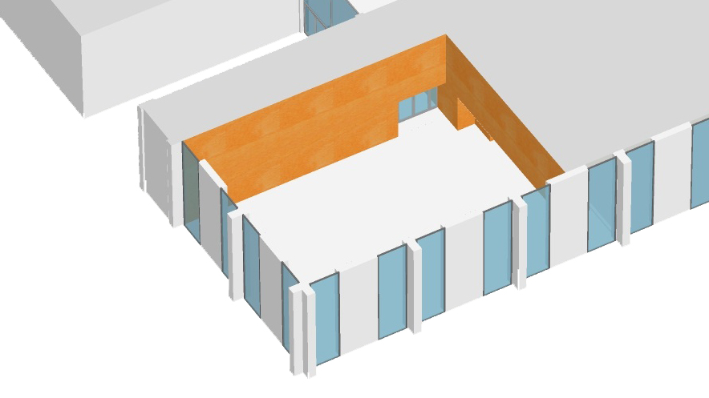
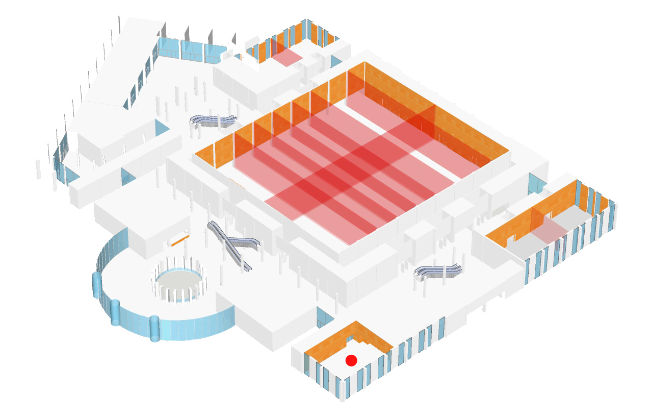
ARCO ROOM
GROUND FLOOR
TECHNICAL DATA
Height (m) | Area m2 | Size (m) | Full room capacity | Classroom style | Horseshoe style | Boardroom style | Table service | Cocktail service
4.33 | 318 | 21.35 (max) x 15 | 260 | 140 | 53 | 70 | 184 | 265
TECHNICAL INFORMATION
Floor weight capacity | Hanging fixtures permitted | Flooring | Walls | Ceiling | Natural light | Blackout facilities
2,000 | YES | DARK CHERRY WOOD | LIGHT BEECH WOOD | STRETCHED METAL MESH SOUND-ABSORBING AND SOUND REFLECTING + PERIMETRAL SOUND-ABSORBING PLASTERBOARD | YES | YES
VIRTUAL TOUR LINK - take a 360° virtual tour of the Arco Room at https://en.riminipalacongressi.it/spaces/virtual-tour
Palacongressi di Rimini - Via della Fiera 23 - 47923 Rimini - Italy - Tel +39 0541 711500 - Fax +39 0541 711505
info@riminipalacongressi.it - www.riminipalacongressi.it

Slide 4
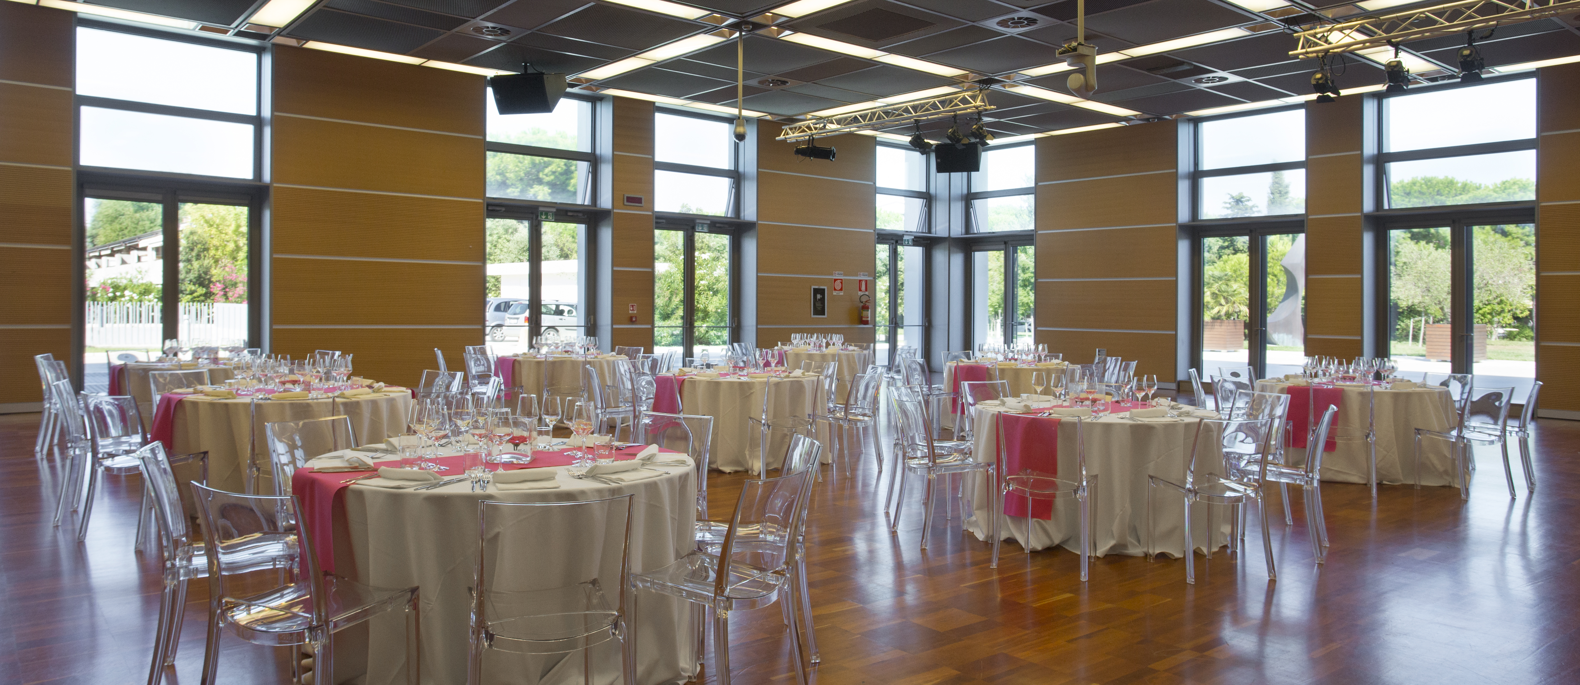
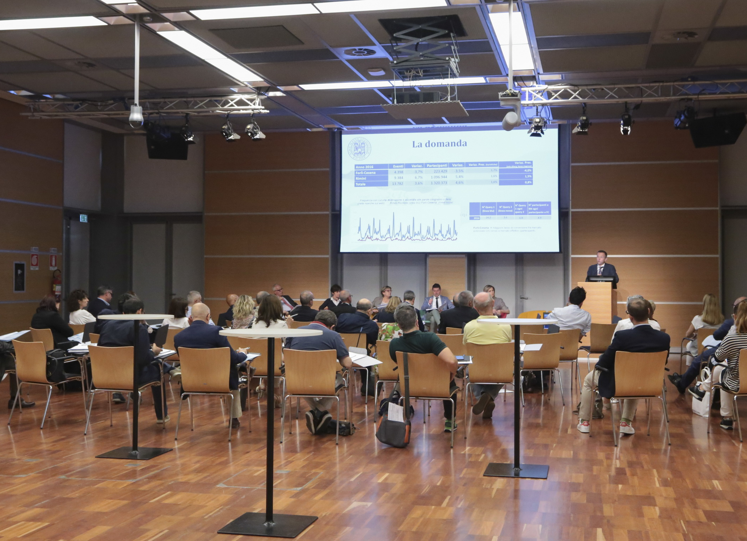
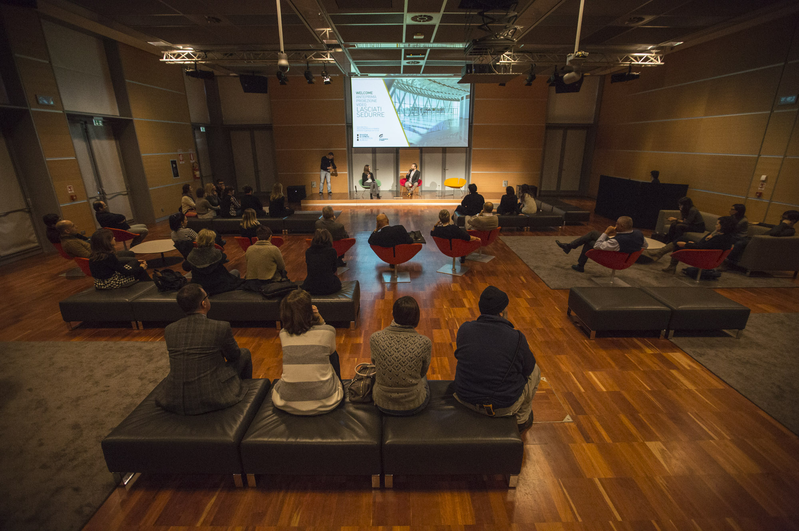
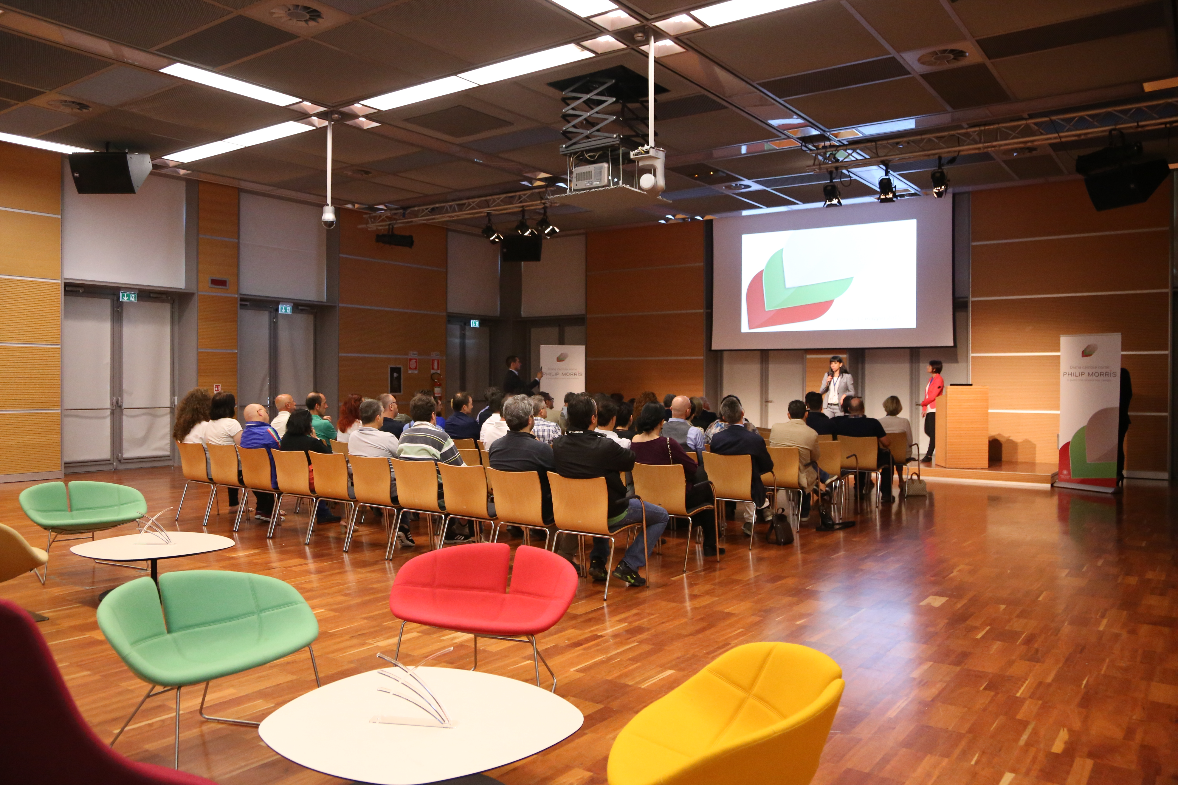
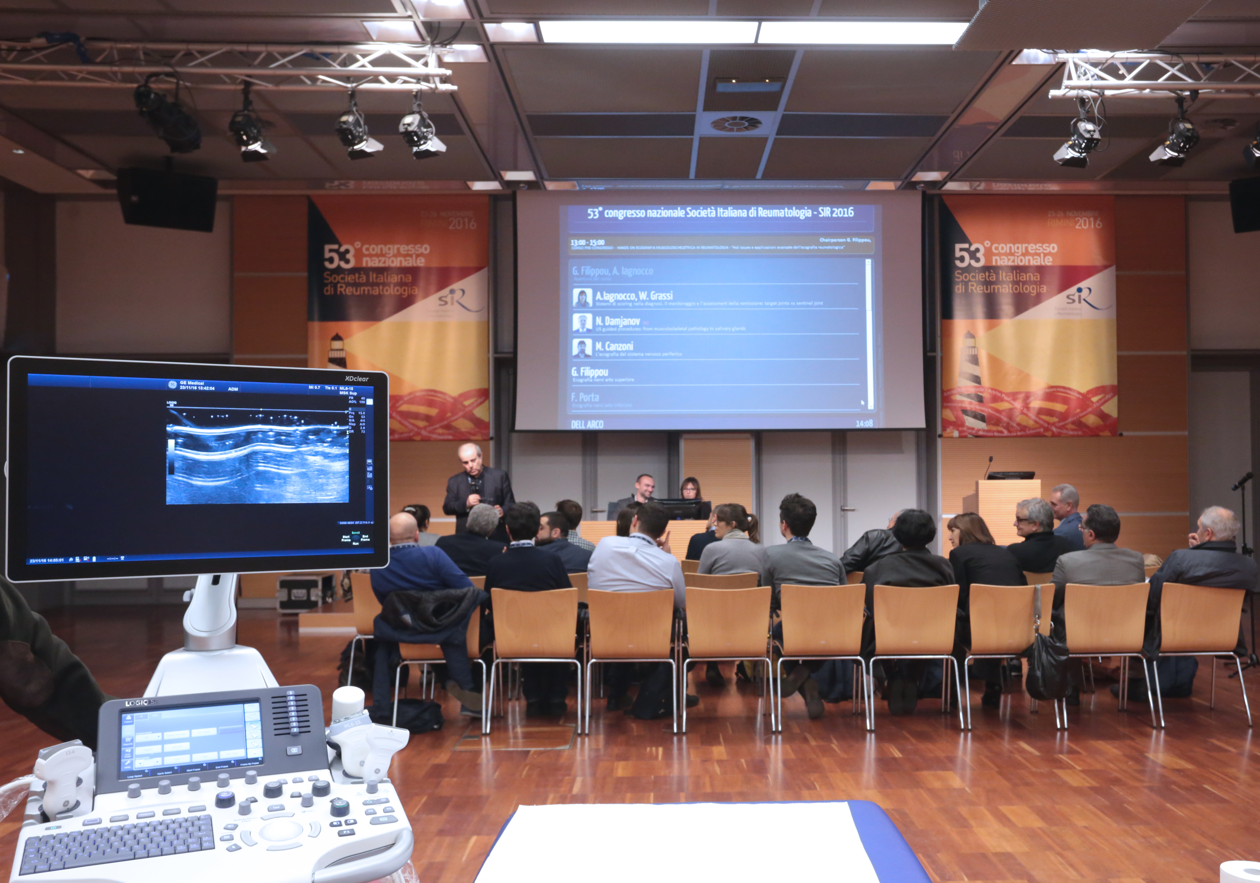
ARCO ROOM
GROUND FLOOR
PHOTOGALLERY
Palacongressi di Rimini - Via della Fiera 23 - 47923 Rimini - Italy - Tel +39 0541 711500 - Fax +39 0541 711505
info@riminipalacongressi.it - www.riminipalacongressi.it

